Slide 1
Identity, Oppression and Resistance
The role of spirituality in the Native struggle to exist
By Sam Seiniger

Slide 2
Liberation Theology
Interpret teachings of Jesus in terms of liberation from unjust systems:
  Political
  Economic
  Social
Clear application to American Indian Christians
Model for IRT use in struggle

Slide 3
Deloria’s Critique
Western Intellectual Tradition
  Space and Time
European Cultural Tradition
  Institutions and Spirit
Christian Religious Tradition
  Legal and experiential language: “ When legal and political words are used to describe religious… doctrines the natural tendency when you face a reluctant audience is to revert to legal and political force to get you views accepted”

Slide 4
Deloria Continued
Problem with the Exodus
Leaves IRT behind
  Liberation IRT doesn’t make sense
  Indians as a poor culture ignores Indians as Indians
Problematic framework
  “by conceptualizing ourselves as oppressed peoples who are to be delivered at all costs, we necessarily become complicit in oppressing those who stand in the way of our deliverance” - Tinkler
“It is only through ideological suspicion that the sources of worldview and value systems can be unmasked and judged, on the basis of justice, for their relative worth.” - Deloria

Slide 5
Decolonization Theory
Equality vs. Liberation
Belief not as means but as goal
Focus on creation
Spatial vs. Temporal
  De-emphasize “progress”
    Development
    Individual rights
Return vs. Reinvention of Religion
Appreciation of culture and identity
  “Reducing our identity as discrete nations to that of a generic, feckless socioeconomic class imposes upon us a particular culture of poverty.” - Deloria

Slide 6
American Indian Identity
Inseparable from Religion
Survival of culture is the one success of resistance
  “The perseverance of these ceremonial forms and of Indian cultures in general in the face of such intense repression and oppression is itself a testament to the tenacity of Indian peoples and their ongoing commitment to resistance and struggle.” - Tinkler
BIA, Nazi Germany, and Apartheid
Being destroyed as final act of genocide
  “Even as we seek new ways to embrace ourselves as Indian communities, the colonizer has found new ways to impede Indian healing and to steal away what is left of Indian identity, cultural values, and traditional life-ways.” - Tinkler
Key to continued resistance and eventual equality
  “[ceremonies] have become symbolic of our continuing cultural resistance to the colonizer at religious, social, and political levels.” - Tinkler

Slide 7
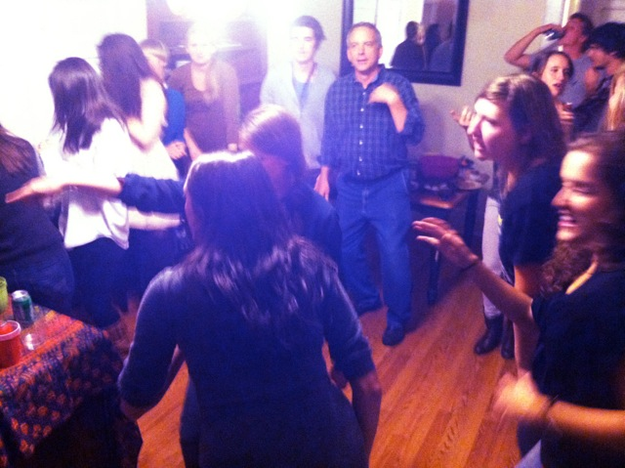
Our Role
Appreciation and continuation of tradition
Deferred reciprocity
Our goals – “euro-american desires for the exotic other of Indianness as as a … spiritual delectable, the other characterized by Indian poverty and need.” - Tinkler
  Social science as the hobby of the wealthy
Colonial tone of academia
White privilege

Slide 8
Our Role
Theft of culture
  “New Agers, to this extent, are finally much more effective in destroying Indian cultural values than several generations of missionaries and government functionaries.” - Tinkler
  Violent abuse victims
  Individualism vs. Collectivism
  Contamination of ceremony and morality “Whites actually introduce the insidious and wicked virus of individualism and ego… into the Indian context” - Tinkler
  Commodification
Unity
  “if I envision myself as a vital part of a community – indeed, as part of many communities – it becomes much more difficult for me to act in ways that destroy any community” - Tinkler
  “How can small communities tied in a thousand ways to the capitalist market system break out without a thorough social, economic and political revolution within the whole country? If a revolution is necessary, then it would seem wise for Native scholars and activists to use any tool that might be helpful in changing society” - Smith

Slide 9
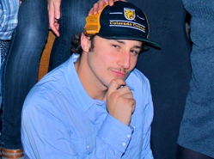
Implications
Welfare benefits
Indian classification
Aid and volunteer work
Education
Urbanization
Media portrayal
Academia

Slide 10
“An American Indian theology coupled with an American Indian Reading of the gospel might provide the theological imagination to generate a more immediate and attainable vision of a just and peaceful world.”
“Dream or imagine the world into existence, just as Spider Woman thought the world into existence in the act of creation.”

Slide 11
Bibliography
Tinkler, George. “Spirit and Resistance.” 2004. Augsberg Fortress. Minneapolis, MN.
Deloria, Vine Jr. God is Red. 2003. Fulcrum Publishing. Golden, CO.
Smith, Andrea. Dismantling the Master's Tools with the Master's House: Native Feminist Liberation Theologies. 2005. http://muse.jhu.edu/journals/journal_of_feminist_studies_in_religion/v022/22.2smith.html
http://jamestreat.files.wordpress.com/2012/10/tchapter3.pdf
http://jamestreat.files.wordpress.com/2012/10/bpart3.pdf
http://en.wikipedia.org/wiki/Liberation_theology#Related_movements
Photos from Laura Sullivan

