Slide 1
UnFrozen: Climate Communication through the use of overplayed Disney songs and a medley of movie references
By Sarah and Nathan

Slide 2
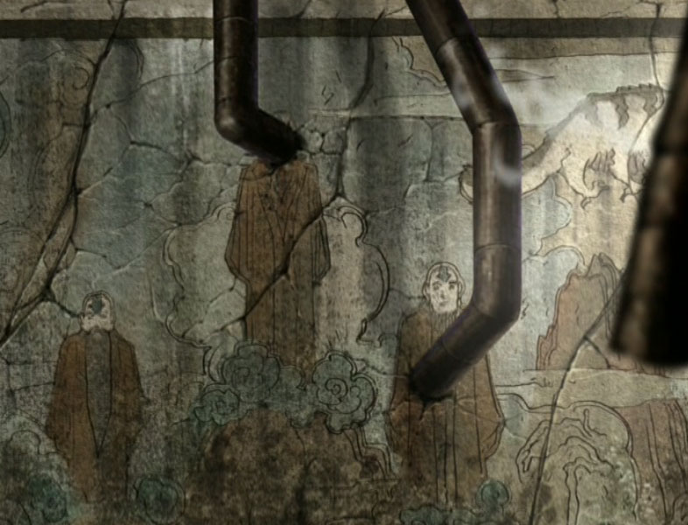
The snow’s glow’s gone on the mountain tonight
Carbon footprints to be seen
A planet of melting ice,
And the forests have lost their green.

Slide 3
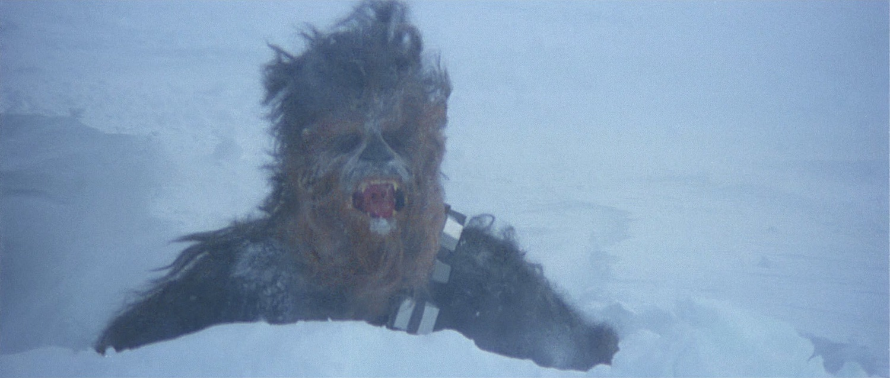
The winds are howling with these swirling storms outside
As climate changes, I am petrified!

Slide 4
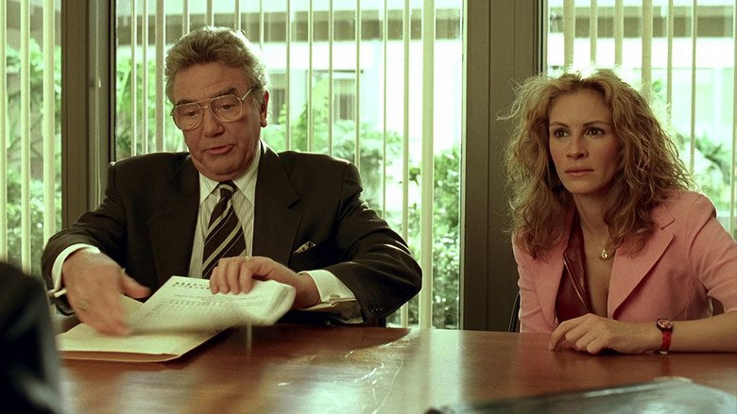
Please let them in, they need to see
Be the citizen you need to be
Reveal, to heal, well now you know,
We’re melting snow!

Slide 5
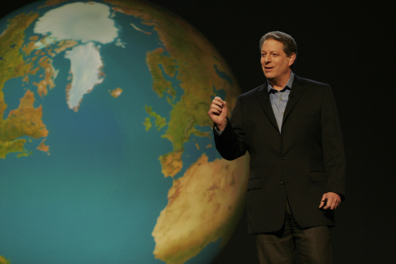
Albedo, Albedo
Can't reflect sun anymore
Albedo, Albedo
We should’ve listened to Al Gore!

Slide 6
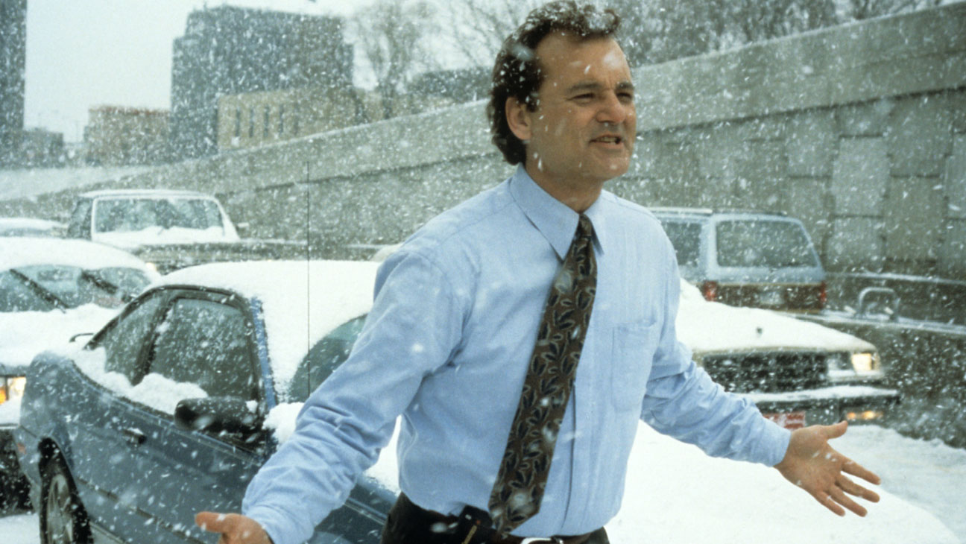
I don't care
What deniers say
Let the Earth live on,
The cold shouldn’t bother you anyway!

Slide 7
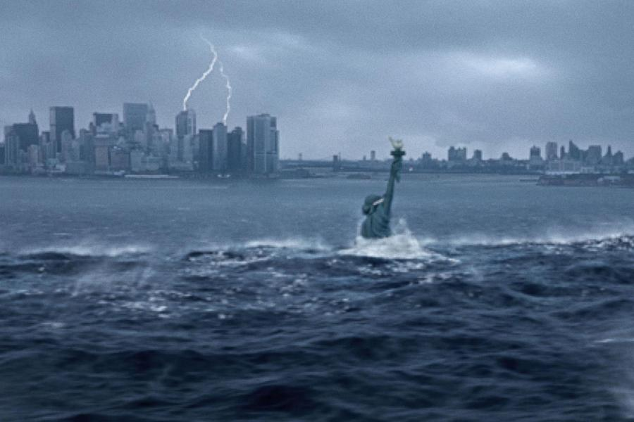
Scary how distant epochs
Make 2 degrees seem small
And the fears of rising oceans
Can't get through to us at all!

Slide 8
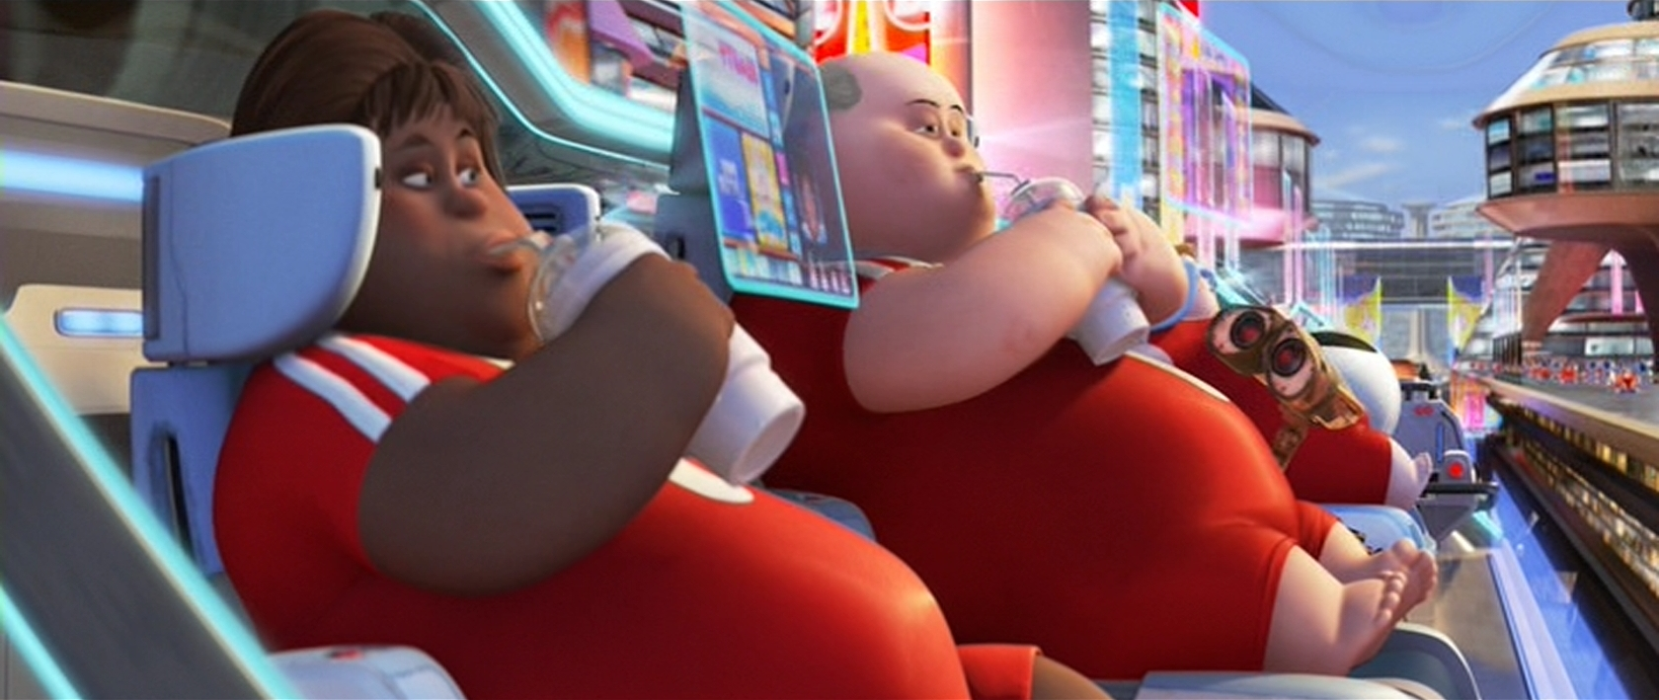
It's time to see what we can do
To fix emissions through and through
To do what’s right for future needs-posterity!

Slide 9
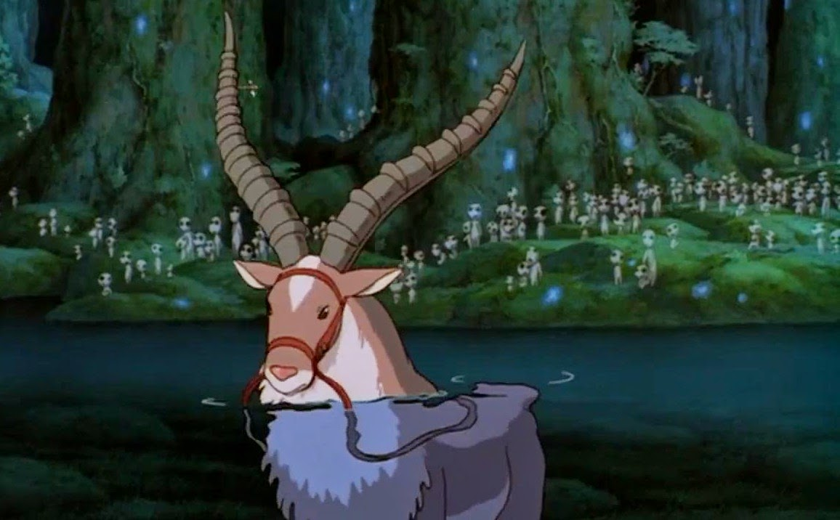
Let it show, let it show
We care for the wind and sky
Let it show, let it show
You'll never let Earth die!

Slide 10
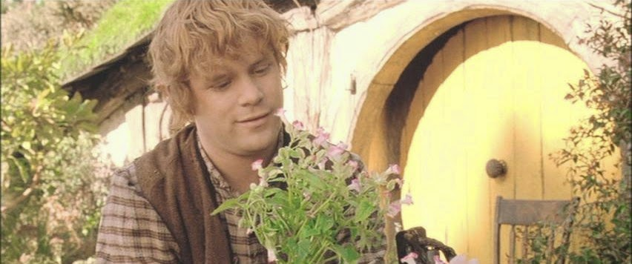
Here we stand
And here we’ll stay
Let the Earth live on!

Slide 11
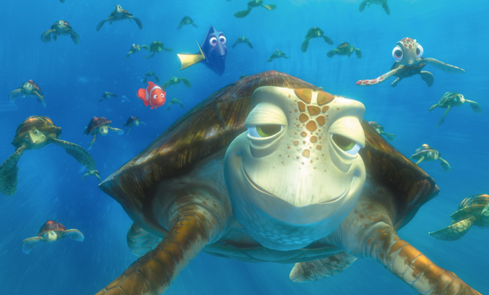
Instrumental- Just wanted to include the turtles

Slide 12
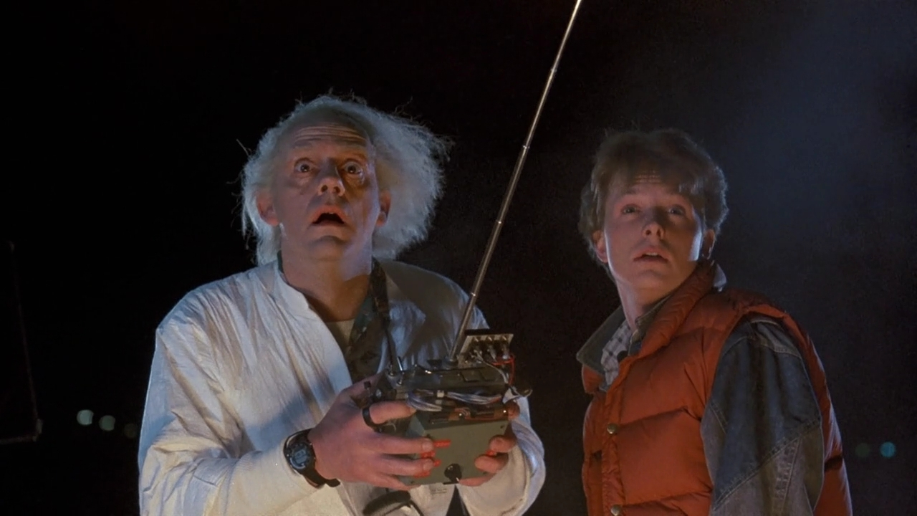
Acid rain flows through the air into the ground
Storms are spiraling in ENSO madness all around
And one thought crystallizes like an icy blast
That we can change this fate,
If we start acting fast!

Slide 13
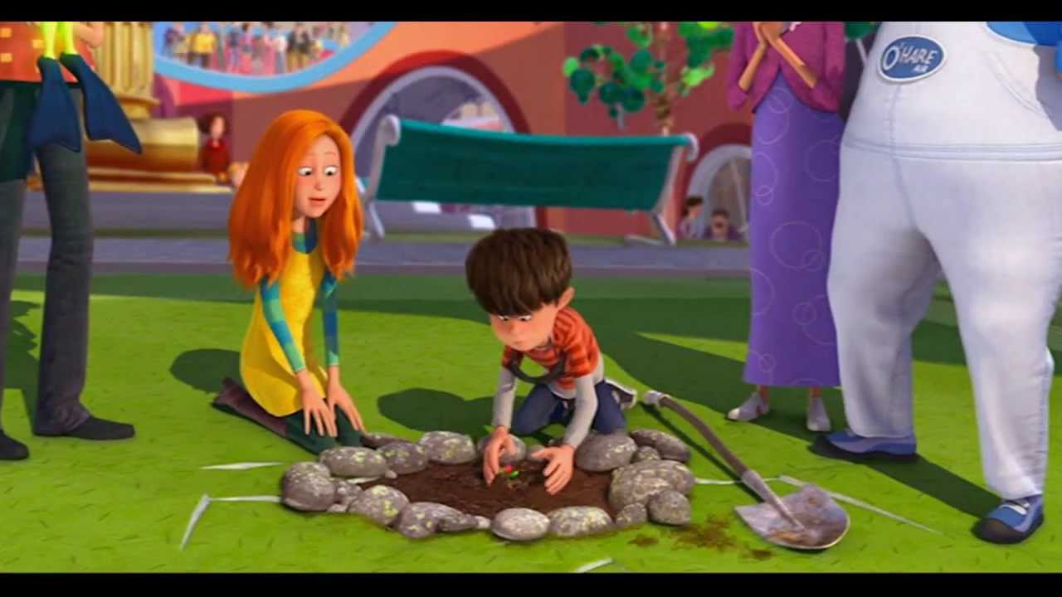
Let trees grow, let trees grow
And they’ll rise like the break of dawn
Let trees grow, let trees grow
Or temps will rise till we are gone!

Slide 14
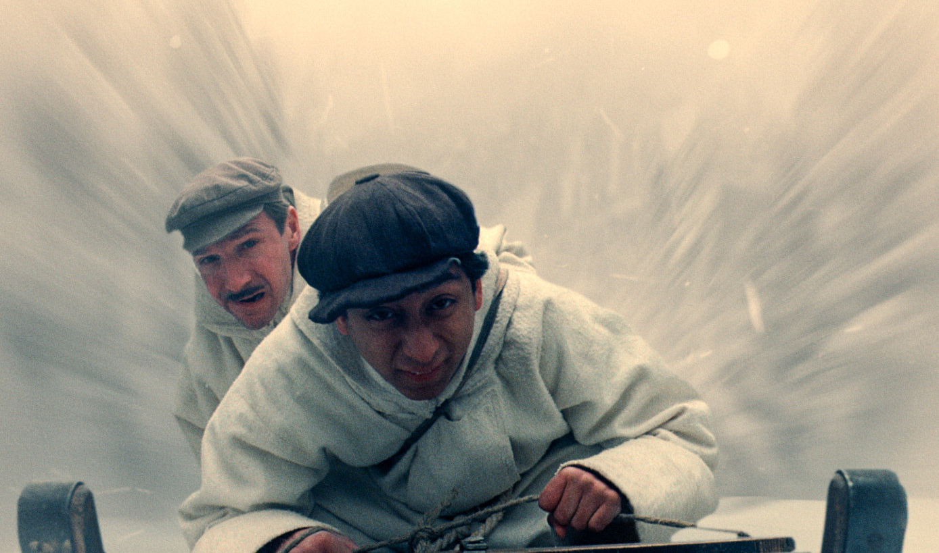
Here we stand
With one thing to say
Let the Earth live on,
The cold shouldn’t bother you anyway!

Slide 15
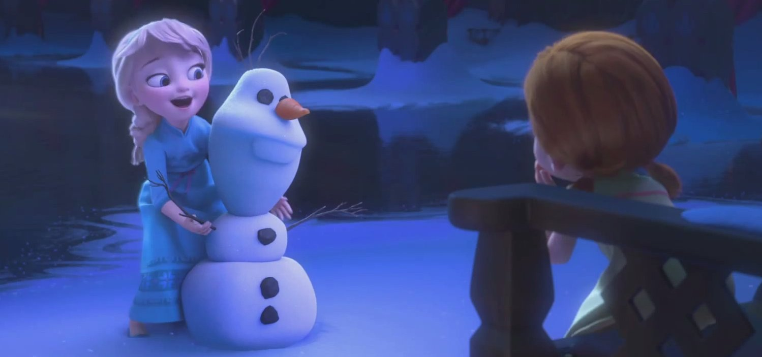
(If you want to build a snowman)

Slide 16
http://audreymgonzalez.com/wp-content/uploads/2012/04/02History.jpg
http://www.propstore.com/product-images/516/177997.jpg
https://image.tmdb.org/t/p/w780/b21P45NQHZ9J8C871pNBrK0rJr3.jpg
https://c1.staticflickr.com/1/110/292526441_a23903ef98.jpg
http://www.hollywoodreporter.com/sites/default/files/2013/11/Groundhog_Day_a_l.jpg
http://img.welt.de/img/geschichte/crop128304095/9276931440-ci3x2l-w900/THE-DAY-AFTER-TOMORROW-3-.jpg
https://scifiinterfaces.files.wordpress.com/2014/01/walle-hoverchair05.jpg
http://3.bp.blogspot.com/-AAnajsj7vUA/U_WxPkVNxLI/AAAAAAAAA2M/KlSGDAS8OzQ/s1600/yakul%2Bkodama%2Bprincess%2Bmononoke.jpg
http://2.bp.blogspot.com/-ZJpcEBvBvO0/U59D11JImCI/AAAAAAAAF0Y/1Dy6A0ol8Bc/s1600/%28FOTR%29+Sam's+Flowers+%282%29.jpg
http://a.dolimg.com/en-US/blogs/wp-content/uploads/2013/09/FindingNemo61.jpg
http://i.kinja-img.com/gawker-media/image/upload/d2q1pyq2gid7esuvmlga.jpg
https://i.ytimg.com/vi/cQK7bjYQWQw/maxresdefault.jpg
http://media.al.com/alphotos/photo/2015/02/25/snow-movies-2015-40aa2377f8e3bbd0.jpg
http://static5.businessinsider.com/image/5400f4e2eab8ea5915bf4e00-1499-703/do-you-want-to-build-a-snowman-frozen.png

