Slide 1
An Introduction to Sign-Up Genius: the many benefits of using a new scheduling system

Slide 2
Sign-up Genius Docent Benefits
Simple to sign-up and operate
Multiple and varied uses
Maintains structure already in place
Allows for easy group messaging
Participation and Volunteer tracking

Slide 3
Simple to operate
NOTE: Tim King has already piloted site with theater ushers and has been using for over a year
An invite is sent to possible participants via email
Each participant has the autonomy to sign-up or to abstain
Once a person has volunteered, the specific position shows as “filled” online and is no longer available for other volunteers to fill
A reminder email is sent to those who have signed up prior a week prior to the tour date

Slide 4
Multiple and varied uses-
The website can be used to schedule all types of docent events, including, but not limited to:
Tours
Meetings
Training Sessions
Additionally, specific “types” of positions can be designated for each event. For example, on an event invite, a docent could designate themselves as:
Meeting attendee
OR
Snack provider

Slide 5
Can keep day-of-the-week/availability structure already in place
  Event invites can be sent to specific groups based on docent availability. Essentially, we are able to keep scheduling structures consistent
  For example: Wednesday tour docents will receive signups for only Wednesdays while Friday tour docents will receive requests exclusively for Fridays. If vacancies remain on a scheduling date, we have the capability of sending sub requests to substitute docents for a particular day.
  Note: Docents will maintain autonomy in choosing tour dates. If they are unavailable or unable to tour, they can choose not to sign up.

Slide 6
Group Messaging
Each time a tour is requested or a meeting is scheduled an initial email requesting sign-up will be sent out
After a docent has signed up to either attend a meeting or tour a week or so before the event, a reminder email is sent to participants
If the event is changed or new information is received concerning a tour, update notifications can also be sent to all participating docents

Slide 7
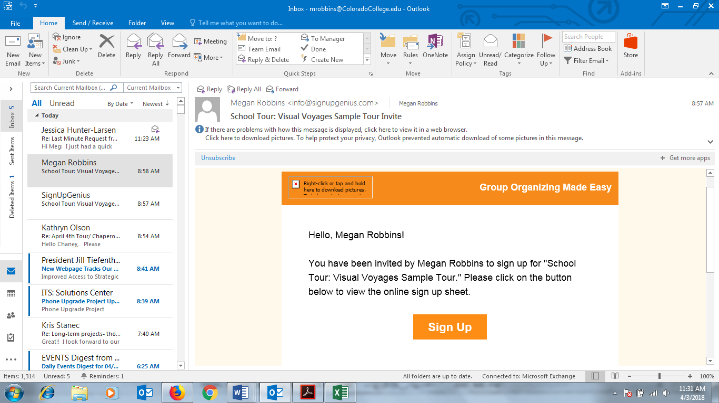
Email format:
Click to go to webpage

Slide 8
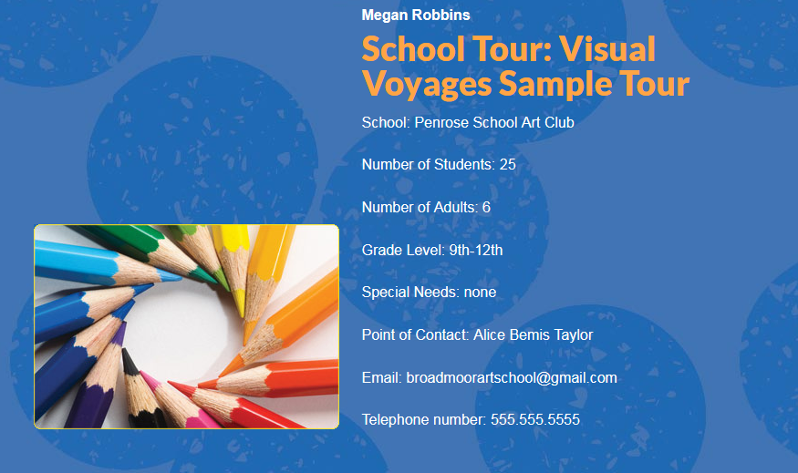
The link will bring docents to the tour or meeting page. It will look something like this…
All tour information can be found here

Slide 9
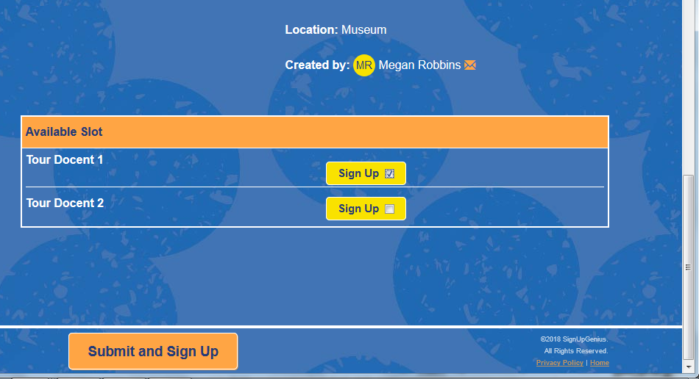
Scroll to the bottom of the page. Click preferred sign up slot. Click submit and sign up.

Slide 10
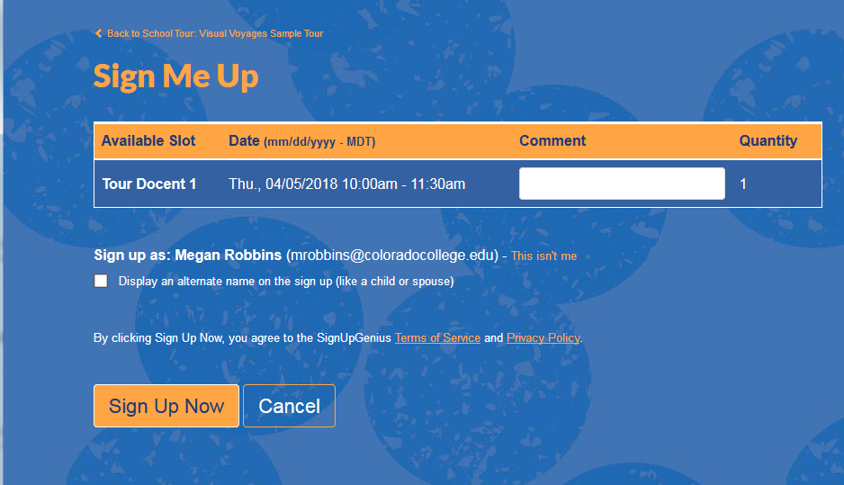
Click the sign up now button

Slide 11
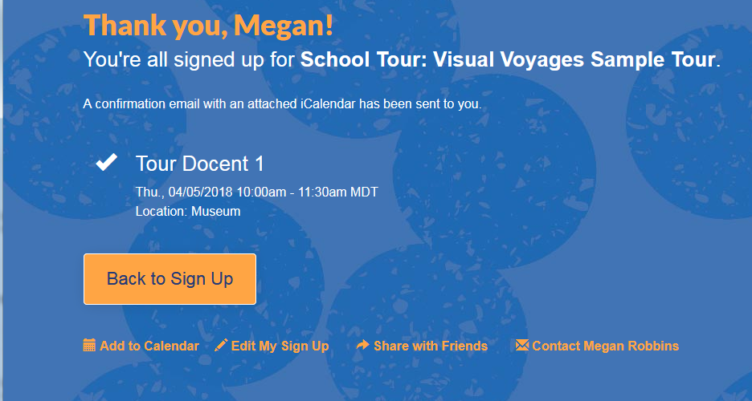
This page signals to you that the sign up was a success! If you would like, you can choose to add the sign up to your personal calendar.

Slide 12
Meeting Attendance and Tour Tracking
Sign-Up Genius allows the tour coordinator to easily track meeting attendance and/or tour participation over a given period of time
Reports can be pulled for any desired length of time for:
  Tours led
  Meetings attended
  OR a combination of the two

