Slide 1
Assistance Animals and the Law
Notes:
Welcome! At The Independence Center we are interested in providing education to our entire community on issues that impact persons with disabilities. This presentation is to help you understand the rights of disabled persons to the services of assistance animals, the support of emotional support animals and how you might differentiate them from family pets.
So for the next little bit, we are going to be looking at the definitions of the different types of animals that may be assisting a person with a disability, the laws that protect that person’s right to those services and situations where the presence of an animal is just not a protected right.

Slide 2
Disclaimer
Information and materials are intended solely as
informal guidance, and are neither a determination of
your legal rights or responsibilities, nor binding on any agency with enforcement responsibility.
Notes:
We’re not lawyers, so the information we’re going to give you today is just to provide you with some guidance and an overview of some things that pertain to service animals, emotional support animals and pets. If you have legal questions it’s best to ask an attorney. We’re just here to share the information that we have with you.

Slide 3


Objectives
Primary focus:
Service animals and the ADA
Other assistance animals under the Fair Housing Act, Colorado Assistance Animal Law, and Air Carrier Access Act
Helpful resources
Notes:
Our objective in providing this training today is for you to come away with a clear understanding of what the current laws, both federal and state say a service animal is, to be able to discuss what other assistance animals might be and the roles of other service animals, to introduce what the FHA and Colorado Law have to say about these things, and finally to provide resources to support you in advocacy and understanding of the rights and responsibilities of service dog ownership.

Slide 4
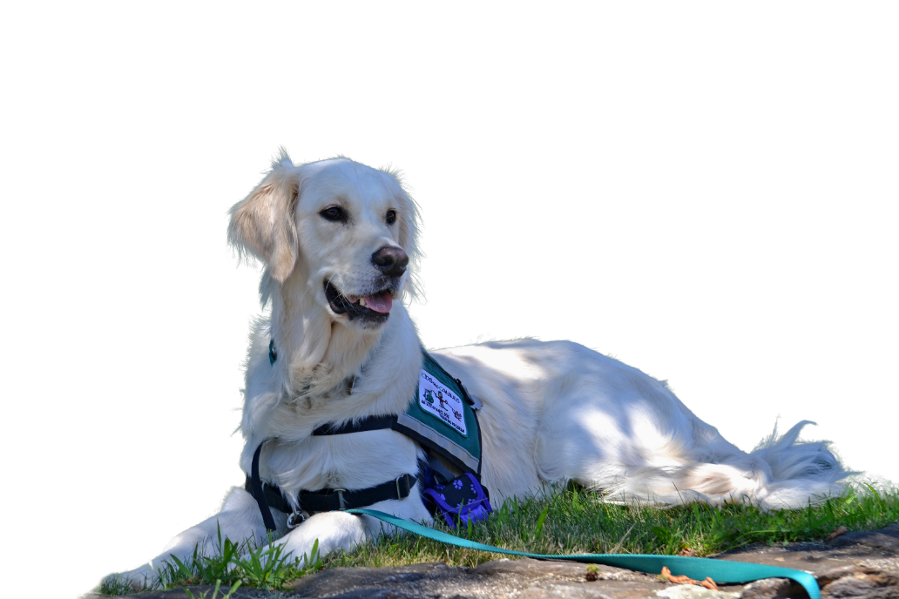
Animals and Disability
Assistance Dogs include Guide Dogs and Service Animals
Psychiatric Service Animal
Emotional Support Animal (ESA)
or comfort animal
Therapy Animal
Pet
Notes:
When we talk about service animals there are all sorts of opinions and impressions about what they are. And there is a lot of fear around violating someone’s rights to a service animal. But, when you understand the rules, it’s really not particularly overwhelming or scary. There are basically three categories of animals that we can consider: Service Animals, Emotional Support Animals (ESA), and pets.

Slide 5

What is a Service Animal?
A dog or a miniature horse that has been individually or specially trained to do work or perform tasks for an individual with a disability to mitigate the disability
Notes:
According to the Americans with Disabilities Act, only 2 species of animal can be true service animals. A dog and a miniature horse. Now, in order for that animal to be considered a service animal the handler must have a disability that requires a specific service provided by the animal as a result of disability. And, the dog or horse has to have been individually trained to do the work or required task.

Slide 6

How do I know if it IS a Service Animal?
You can legally ask two questions to make the determination:
Is the dog a service animal required because of a disability?
What work or task has the dog been trained to perform?
Notes:
Just these two questions. And, in addition, you can’t require that a person with a disability reveal their disability. Did you notice that no where in these two allowed questions are you allowed to say “What is your disability?” To that end, a person may legally say that they don’t wish to explain the task that the animal has been trained to do as it would reveal their disability which they wish to keep private.

Slide 7

What is an Emotional Support Animal?
Often used as part of a medical treatment plan as support and therapy animals
They are not considered service animals under the ADA
Help with depression, anxiety, and certain phobias, but do not have special training to perform tasks that assist people with disabilities
Provides comfort
Notes:
There are some people that confuse the terminology including professionals, so I want to make clear that for the purposes of this presentation we are equating companion animals with pets. So, you’ll want to be clear in discussing animals whether you are talking about a necessary emotional support animal (recognized under the Fair Housing Act and the Air Carrier Access Act) or a pet.

Slide 8

Companion Animals/Pets
People use the term “companion animal” interchangeably with “pet”
However, some also use the term to explain an ESA. Be sure to clarify
People who present with a pet do not have any of the legal rights afforded to people with disabilities who have a service animal or emotional support animal
Notes:
Always want to view the situation from the person’s point of view – not the animal’s. It’s the person with a disability who has the right of access.

Slide 9
ADA Definition of Disability
Physical or mental impairment that
substantially limits a major life activity
Record of an impairment
Regarded as having an impairment
Notes:
These three bullet points fly in individually with click of mouse.
What is a disability? One of the laws actually defines it and we’ll use the next few slides to make clear the legal definition of a person with a disability and the rights they have to the service or assistance of an animal.

Slide 10
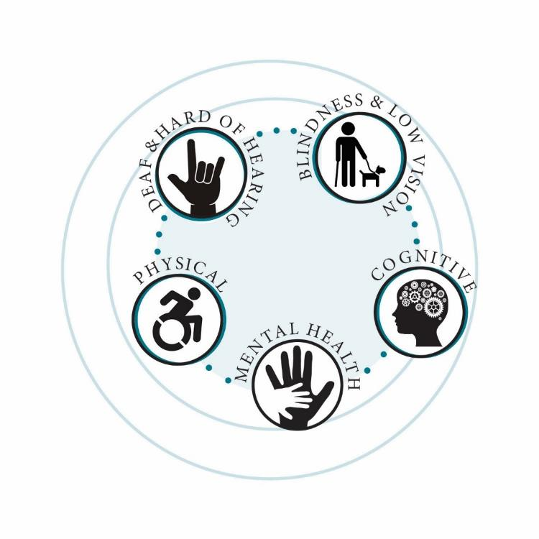
…impairment that substantially limits . . .
Performance in major life activity compared to most people in
general population
Effect of impairment on person’s life
Not name of impairment
Notes:
Did you notice in the previous slide that the name of the impairment isn’t part of the definition? It’s the effect that any impairment has overall. So, when we consider the effect, we have to consider performance in that particular activity compared with the general population.

Slide 11
Major Life Activities Defined
Activity most people can perform with little or no difficulty
Caring for oneself
Performing manual tasks
Seeing
Hearing
Eating
Sleeping
Walking
Standing
Lifting
Bending
Speaking
Breathing
Learning
Reading
Thinking
Communicating
Working
Notes:
These activities include caring for oneself, performing manual tasks, seeing, hearing, eating, sleeping, walking, standing, lifting, bending

Slide 12
Life Activity is also
Operation of a major bodily function
Like functions of the immune system, normal cell growth, respiratory, circulatory, or endocrine systems
Animal Can Alert
  When a person with diabetes has low blood sugar
  Prior to the on-set of a seizure
  In the presence of allergens present that create a threat to the handler’s well-being
Notes:
a major life activity also includes the operation of a major bodily function, including but not limited to, functions of the immune system, normal cell growth, digestive, bowel, bladder, neurological, brain, respiratory, circulatory, endocrine, and reproductive functions

Slide 13
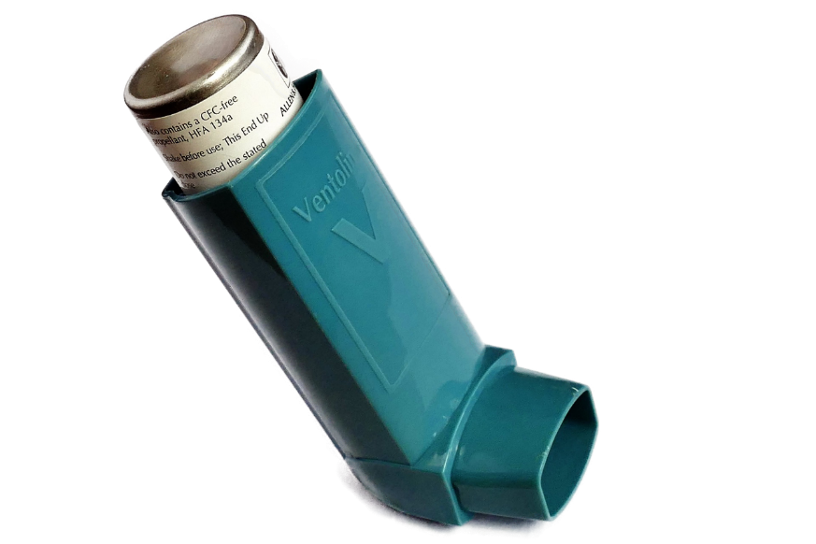
“Invisible” Disabilities
Epilepsy
Fibromyalgia
Heart Conditions
Hemophilia
Hepatitis
Intellectual
Migraines
    Multiple Chemical Sensitivity
Psychiatric
PTSD
Sleep Disorders
TBI
ADHD
AIDS/HIV
Alcoholism
Allergies
Arthritis
Asthma
Cancer
Chronic fatigue
Color blindness
Deafness/Hard of Hearing
Diabetes
Notes:
What do you think some invisible disabilities are? (Get a few from the audience and then quickly click through these. Make sure to read them if there is anyone in the audience with a visual impairment.

Slide 14

NO laws apply to
Pets, sometimes called companion animals

Slide 15
Some types of training
Autism
  Repetitive movement alerts
Blind/Low Vision
  Orientation and mobility
Deaf/Hard of Hearing
  Alerting to auditory stimuli
Tasks directly related to disability:
Mobility disability
  Pulling wheelchair
  Retrieving objects
  Balance support
Psychiatric disability
  Agitation warning
  (deter inappropriate behavior)
  Medication reminder
Sole function - provide comfort or emotional support: NOT service animal
Notes:
Because the laws allow asking only two questions of a person with an animal:
Is the dog required because of your disability?
What task does it perform?
We give you these examples only as illustration. Keep in mind that many disabilities are hidden and even though the need for the dog may not be obvious, that doesn’t mean that it isn’t a service dog.

Slide 16
Innate Tasks
Allergies
  Allergen warning
Diabetes
  Blood sugar warning
Tasks directly related to disability:
Seizures
  Alerting prior to seizure
  Protecting during seizure
  Seeks help

Slide 17
Four Different Laws
The Americans with Disabilities Act (1990)
Fair Housing Act (1988)
Colorado Assistance Animal Law
Air Carrier Access Act

Slide 18
Americans with Disabilities Act
The Americans with Disabilities Act of 1990 (ADA) prohibits discrimination and ensures equal opportunity for persons with disabilities in employment, State and local government services, public accommodations, commercial facilities, and transportation
Notes:
Note here that this law gives access to PEOPLE with disabilities . . . Not the animal.

Slide 19
Fair Housing Act
Prohibits housing discrimination on the basis of:
  Color Disability
  Familial status National origin
  Race Religion
  Sex
Requires exceptions in policies/operations to afford people with disabilities equal housing opportunities

Slide 20
Fair Housing Act
Because of disability of:
Individual
Individual associated with buyer/renter
Individual who intends to live in residence
Unlawful to discriminate in:
Selling
Renting
Advertising
Financing
New Construction
Zoning

Slide 21
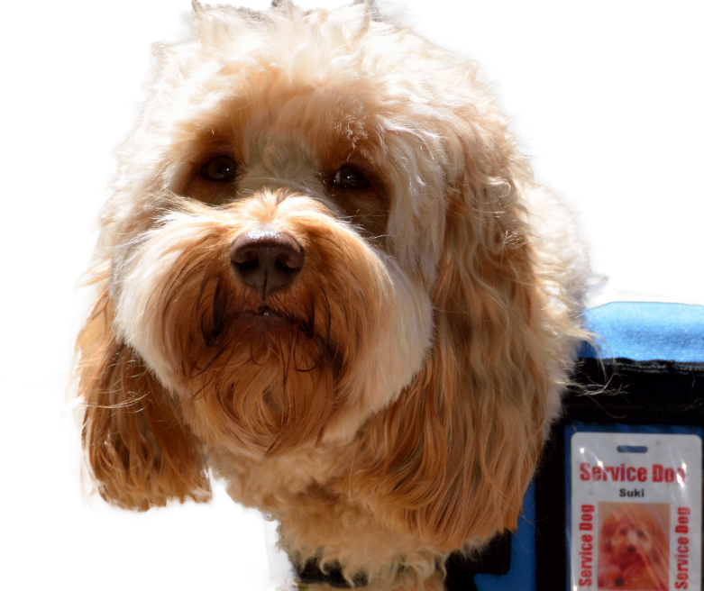
Colorado Assistance Animal Law
Individual with a disability must be allowed to be accompanied by an animal that has been trained to provide a service
Service animal trainer must be allowed to be accompanied by an animal that is being trained

Slide 22

Air Carrier Access Act
The Air Carrier Access Act prohibits discrimination on the basis of disability in air travel and requires air carriers to accommodate the needs of passengers with disabilities

Slide 23
Who Is Impacted?
AMERICANS WITH DISABILITIES ACT (1990)
Assisted living facilities Public housing Shelters Student housing Public and private schools Transportation All state and local government employment Private employment: 15 or more employees Private businesses (sales and leasing offices) Telecommunications

Slide 24
Who Is Impacted?
FAIR HOUSING ACT (1988)
Housing receiving Federal financial assistance State and local government housing Private housing Homeowner’s associations

Slide 25
Who Is Impacted?
COLORADO ASSISTANCE ANIMAL LAW
24-34-803: Rights of persons with assistance dogs Public Housing (except single family residence or occupants who rent, lease, or furnish for compensation one room in residence) Employment

Slide 26
Who Is Impacted?
Air Carrier Access Act
All flights of U.S. airlines, and flights to or from the United States by foreign airlines

Slide 27
What is an Allowed Animal in
Each of the Laws?
AMERICANS WITH DISABILITIES ACT
Any dog or miniature horse that is individually trained to do work or perform tasks for the benefit of an individual with a disability; work or tasks must be directly related to disability

Slide 28
What is an Allowed Animal in
Each of the Laws?
FAIR HOUSING ACT
Animal that works, provides assistance, or performs tasks for the benefit of a person with a disability, or provides emotional support that alleviates one or more identified symptoms or effects of a person's disability
Notes:
So, in Fair Housing they are allowing ESA in definition

Slide 29
What is an Allowed Animal in
Each of the Laws?
COLORADO ASSISTANCE ANIMAL LAW
Animal that has been or is being trained to perform one or more specific functions for a person with a disability

Slide 30
What is an Allowed Animal in
Each of the Laws?
Air Carrier Access Act
The Air Carrier Access Act requires air carriers to permit service animals to travel in the cabin with their disabled handlers unless an animal physically does not fit in the space allotted to the traveler and there is no other space on board to accommodate them. If the animal will not fit in the cabin, the air carrier must offer to transport the animal as cargo, free of charge. It also makes some provision for Emotional Support Animals

Slide 31
What is an Allowed Animal in
Each of the Laws?
Air Carrier Access Act
The handler must present a letter from a licensed mental health professional which: * must not be more than one year old * must be on the professional's letterhead * must be from a mental health professional
Notes:
Note it is not just a mental illness diagnosis, but a mental illness which SUBSTANTIALLY LIMITS ONE OR MORE MAJOR LIFE ACTIVITIES.

Slide 32
What is an Allowed Animal in
Each of the Laws?
Air Carrier Access Act
Letter must state all of the following: 1. That the passenger has a mental health-related DISABILITY 2. That the presence of the animal is NECESSARY to the passenger's health or treatment 3. That the individual writing the letter is a licensed mental health professional and that the passenger is under his or her care
Notes:
Note it is not just a mental illness diagnosis, but a mental illness which SUBSTANTIALLY LIMITS ONE OR MORE MAJOR LIFE ACTIVITIES.

Slide 33
What is an Allowed Animal in
Each of the Laws?
Air Carrier Access Act
Know BEFORE you go: The interpretation of the rules can vary from airline to airline. For ease in travelling, please contact your airline to learn how to best navigate their rules.
Notes:
However, every airline has different documentation requirements and you should contact them for specifics before opening yourself to the frustration of misunderstandings.

Slide 34
Service Animal Etiquette
A service animal’s job is to assist owner
Any time you see a working dog in public you should not interrupt their work
Do not pet, feed, or distract service animals
Safety risk: accidents can occur if animal is distracted

Slide 35
Service Animal Access
“No pets” policy does not include service animals – they are allowed access wherever public is allowed
EVEN where food is served and even if state or local health codes prohibit animals

Slide 36
Can I Deny the Animal Access?
Based on a No Pets Rule?
AMERICANS WITH DISABILITIES ACT | FAIR HOUSING ACT | COLORADO ASSISTANCE ANIMAL LAW | AIR CARRIER ACCESS ACT
No | No; equal opportunity to enjoy and use dwelling | No | No

Slide 37
Can I Deny the Animal Access?
Based on the animal’s status as “in-training”?
AMERICANS WITH DISABILITIES ACT | FAIR HOUSING ACT | COLORADO ASSISTANCE ANIMAL LAW | AIR CARRIER ACCESS ACT
Only allowed as a work-place accommodation, if being trained to assist with work tasks | Must facilitate person's ability to function in their home | Yes | Yes

Slide 38
Can I Deny the Animal Access?
Based on the fact that the animal is not a service animal, but an emotional support animal?
AMERICANS WITH DISABILITIES ACT | FAIR HOUSING ACT | COLORADO ASSISTANCE ANIMAL LAW | AIR CARRIER ACCESS ACT
Yes, if not a reasonable accommodation in workplace | No | Not mentioned in Colorado Revised Statutes 2014 | No. But there are requirements for documentation that vary from airline to airline

Slide 39
Can I ask?
Can I ask about the nature or extent of the person’s disability?
AMERICANS WITH DISABILITIES ACT | FAIR HOUSING ACT | COLORADO ASSISTANCE ANIMAL LAW | AIR CARRIER ACCESS ACT
No | No | Not mentioned in Colorado statute | No

Slide 40
Can I ask for Documentation?
AMERICANS WITH DISABILITIES ACT | FAIR HOUSING ACT | COLORADO ASSISTANCE ANIMAL LAW | AIR CARRIER ACCESS ACT
For workplace accommodation if need in workplace unclear; how animal will help individual perform job | Written (physician, psychiatrist, social worker, mental health professional): need for/how animal will assist person with specific disability | Not mentioned in Colorado Revised Statutes 2014 | Yes. For service animals, there are 3 questions. For emotional support animals, each airline has different questions that are allowed by ACAA

Slide 41
Permitted Legal Inquiries
AMERICANS WITH DISABILITIES ACT | FAIR HOUSING ACT | COLORADO ASSISTANCE ANIMAL LAW | AIR CARRIER ACCESS ACT
Only if not obvious: Animal required because of a disability? What work or task has animal been trained to perform? | How reasonable accommodation mitigates symptoms of the disability | Not mentioned in Colorado Revised Statutes 2014 | 1. What tasks or functions does your animal perform for you? 2. What has your animal been trained to do for you? 3. Would you describe how the animal performs this task for you?

Slide 42
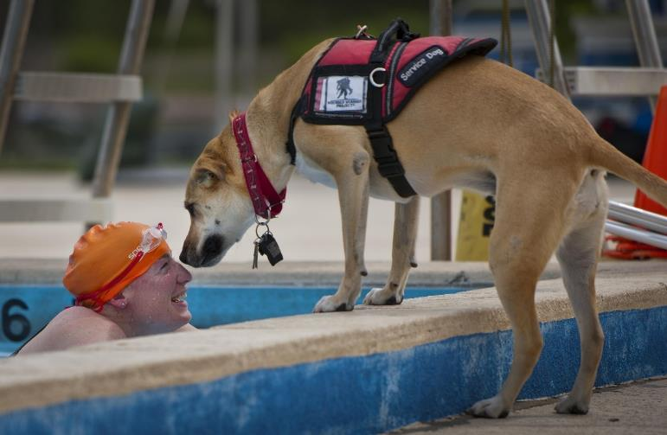
Prohibited
  Cannot require:
  Certification papers
  Identification card
  Vest
  Requiring proof of
  license/vaccinations permitted

Slide 43
Other Questions that are often asked
Can there be deposits or fees required of a service animal?
AMERICANS WITH DISABILITIES ACT | FAIR HOUSING ACT | COLORADO ASSISTANCE ANIMAL LAW | AIR CARRIER ACCESS ACT
No, even if pet deposits permitted; fees permitted only after damage | No, even if pet fees permitted; only after damage | Only after damage; Service animals are exempt from licensing fees | Only after damage

Slide 44
Other Questions that are often asked
Can an animal be denied based on allergy or fears?
AMERICANS WITH DISABILITIES ACT | FAIR HOUSING ACT | COLORADO ASSISTANCE ANIMAL LAW | AIR CARRIER ACCESS ACT
No | No | No | No

Slide 45
Other Questions that are often asked
Can an animal be denied based on breed?
AMERICANS WITH DISABILITIES ACT | FAIR HOUSING ACT | COLORADO ASSISTANCE ANIMAL LAW | AIR CARRIER ACCESS ACT
No | Only when landlord’s insurance carrier refuses, or substantially increases cost of coverage, and no comparable insurance available | Not mentioned in Colorado Revised Statutes 2014 | Not mentioned

Slide 46
Valid Denial
AMERICANS WITH DISABILITIES ACT
Person with disability does not control animal (growling, uncontrolled barking, jumping on people, running away from handler) Not housebroken Individualized assessment: direct threat to health or safety of others Type, size, weight of horse Workplace: undue hardship or direct threat Must offer opportunity to obtain goods/services without animal present

Slide 47
Valid Denial
FAIR HOUSING ACT
Individualized assessment: direct threat to health or safety of others or substantial physical damage to the property of others that cannot be reduced or eliminated by another reasonable accommodation Undue financial and administrative burden Would fundamentally alter the nature of the housing provider's services

Slide 48
Valid Denial
COLORADO ASSISTANCE ANIMAL LAW
Employment: undue hardship to employer (significant difficulty or expense)

Slide 49
Valid Denial
AIR CARRIER ACCESS ACT
Animals such as miniature horses, pigs, and monkeys may be considered service animals. A carrier must decide on a case-by-case basis according to factors such as the animal’s size and weight; state and foreign country restrictions; whether or not the animal would pose a direct threat to the health or safety of others; or cause a fundamental alteration in the cabin service

Slide 50
Service Animals in Schools
For Grades K-12
  Decision is made by IEP Team (IDEA) or
    Individual Accommodation Plan (Rehab Act Section 504) Committee
    Usually comfort/emotional support animals
  Student Must:
    Control animal at all times
    Be responsible for care, clean up,
    feeding, supervision
Postsecondary
  Service animals are permitted:
  See Disability Services Coordinator
  Register as student with disability
  Current license/vaccinations are required

Slide 51
Enforcement
AMERICANS WITH DISABILITIES ACT | FAIR HOUSING ACT | COLORADO ASSISTANCE ANIMAL LAW | AIR CARRIER ACCESS ACT
U.S. Department of Justice (DOJ) 950 Pennsylvania Avenue, N.W. Civil Rights Division Disability Rights Section – NYA Washington, DC 20530 www.ada.gov 800-514-0301 | Department of Housing and Urban Development (HUD) Office of Fair Housing and Equal Opportunity hud.gov/fairhousing 800-669-9777 | Colorado Office of the Attorney General 1300 Broadway, 10th Floor Denver, CO 80203 coag.gov/ 720-508-6000 | Aviation Consumer Protection Division Attn: C-75-D U.S. Department of Transportation 1200 New Jersey Ave, S.E. Washington, DC 20590 800-778-4838 (voice) or 800- 455-9880 (TTY)

Slide 52
Misrepresentation of an Animal
Effective January 1, 2017 Section 18-13-107 of the Colorado Code makes it illegal to falsely represent an animal as a service animal
Charges can range from a petty offense to a misdemeanor, with progressive fines from $25 - $500
The person intentionally misrepresents entitlement to an animal in his or her possession as an assistance animal . . .
Notes:
This law was really designed for extreme violations of misrepresentation.
The goal wasn’t to limit people – that’s why the language uses “intentionally”
Provides an opportunity for good education

Slide 53
Service Animals Resources
Service Animals and Emotional Support Animals
Where Are They Allowed and Under What Conditions?
Revised ADA Requirements:
www.ada.gov/service_animals_2010.htm

Slide 54
Contact
The Independence Center
729 South Tejon Street
Colorado Springs, CO 80903
www.theindependencecenter.org
Phone: 719-471-8181
Video Phone 719-358-2513
Fax 719-471-9322

