Slide 1
Finance Workshop
By: Finance Committee

Slide 2
Operating Budgets & Appealing
Budgets can be used for food, meeting expenses, and supplies. Though we did not specifically fund t-shirts for groups, you get to spend the money how you would like.

Slide 3
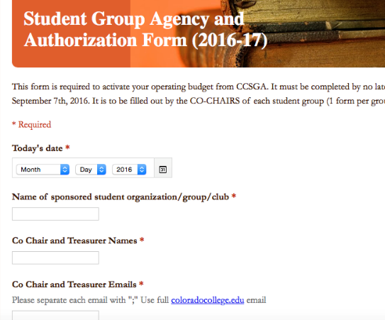
How to Activate your Club Budget Group Account
Step One: Co Chairs must fill out the
Agency and Authorization Form.
This form is found on
the CCSGA website.
Click Finance and
then click “Activate
your Student Group
Account”
Fill it out and hit
submit!

Slide 4
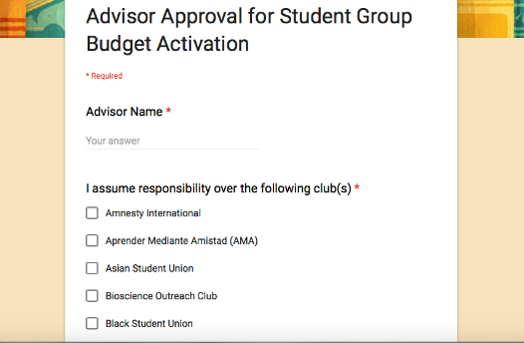
Continued.
Step Two: Once the Finance Committee receives your Agency form we will email your advisor the Advisor Form.

Slide 5
Continued.
Once the Agency & Advisor form are both turned in your group budget account will be activated. It will not be activated until then.
All unspent money from your operating budgets goes back to CCSGA unless you appeal.
Operating Budget codes begin with 151
All of the awarded Operating Budgets will be published on the website shortly.

Slide 6
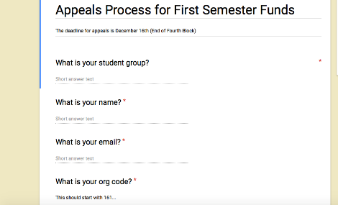
Appeal Process after First Semester
When Can you Appeal?
An Email will be sent out with a form to groups at the beginning of fourth block.
One Week to Appeal
This form will basically ask what your group is planning to do with the rollover funds.

Slide 7
How to Apply For Special Events Funding
If the event is free, open to campus, and non partisan

Slide 8

It All Starts with an Idea
Bring an idea for an event to your group.
Talk about the details
Keep your advisor in the loop
What are you going to need?
Who is the audience?
Where is it going to be?
When is it going to be?
Ask yourself all of these questions ☺
Deadlines are SO important.
Please do not apply to us after an event has
already happened.

Slide 9
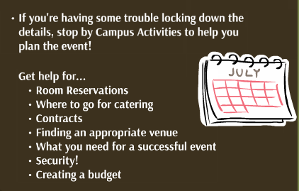
Stop by Campus Activities
PS: Larger events may require security guards.

Slide 10
How to Apply
Go to the CCSGA Website and Click on the Funding tab and then click “Apply for Special Events Funding”
You will need to schedule an appointment to meet with the finance committee. We meet 1st and 3rd week.
  Tuesday: 7:45 pm-8:45 pm
  Thursday 6:00 pm- 7:00 pm
  Full council meets: 7:00 pm every Thursday

Slide 11
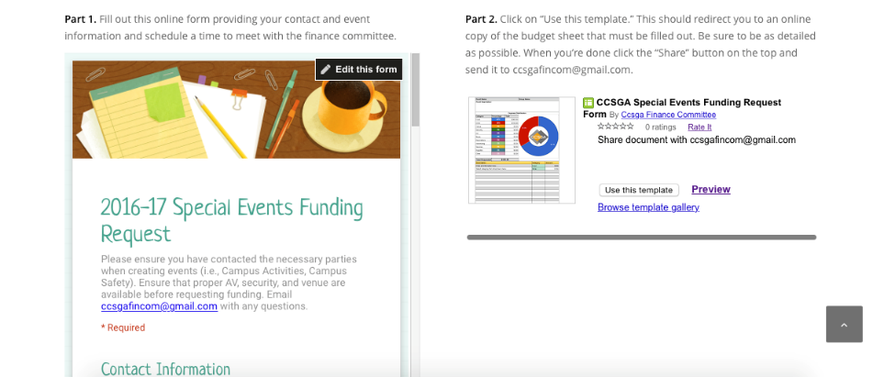
After scheduling an Appointment Fill out Both of These Forms

Slide 12
What Happens at an Appointment with the Finance Committee?
We introduce ourselves!
Your group tells us about the event and goes over the budget sheet you filled out.
The Finance Committee may ask questions.
The end, these meetings usually last 10-15 minutes.

Slide 13
Over $5,000 Events
The Event must be presented to Full Council.
Full Council hears the presentation of the group’s event and budget outline.
The Finance committee will present to all of council after the groups presentation their proposed award they made at their previous meeting.
Full council votes on that award.
We will hear and take into account the opinion of full council
The goal is to have more people voting on events that are more expensive.

Slide 14

Under $5,000 Events & Over $5,000 Events that Presented to Full Council
Finance Committee will email you within two hours of the meeting the funding decision!
If the amount awarded is less than the amount requested, we will work with you to find other funding sources.
If funding is rejected we will let you know our concerns.
  You have the opportunity to reapply after the concerns are addressed.
  We send all of our Special Events Funding Award Updates to the Catalyst every Wednesday. We want to be as transparent as possible.

Slide 15
What’s Next?
We will work with business office to transfer the funds to your student group account. The transfer will take a week.
If you forgot your budget codes or need access, email the finance committee.

Slide 16
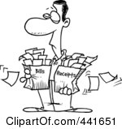
How to Pay for Things
Keep Advisor in the loop at all times!
P Card- Provide budget code and go with them to purchase things.
Pay for it out of pocket and ask for reimbursement.
Keep all of your receipts!
Susan will talk about Cash Advance and Check Requisition.

Slide 17

Enjoy your Event!

