Slide 1
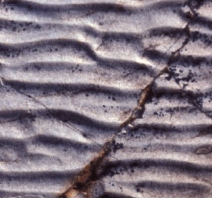
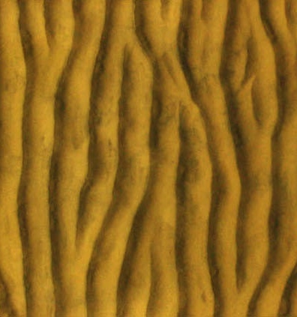
Dynamics and adjustment of wave ripples
Colleagues at
Massachusetts Institute of Technology
Taylor Perron, Justin Kao, Kim Huppert, Abby Koss, Jocelyn Fuentes, and John Southard

Slide 2
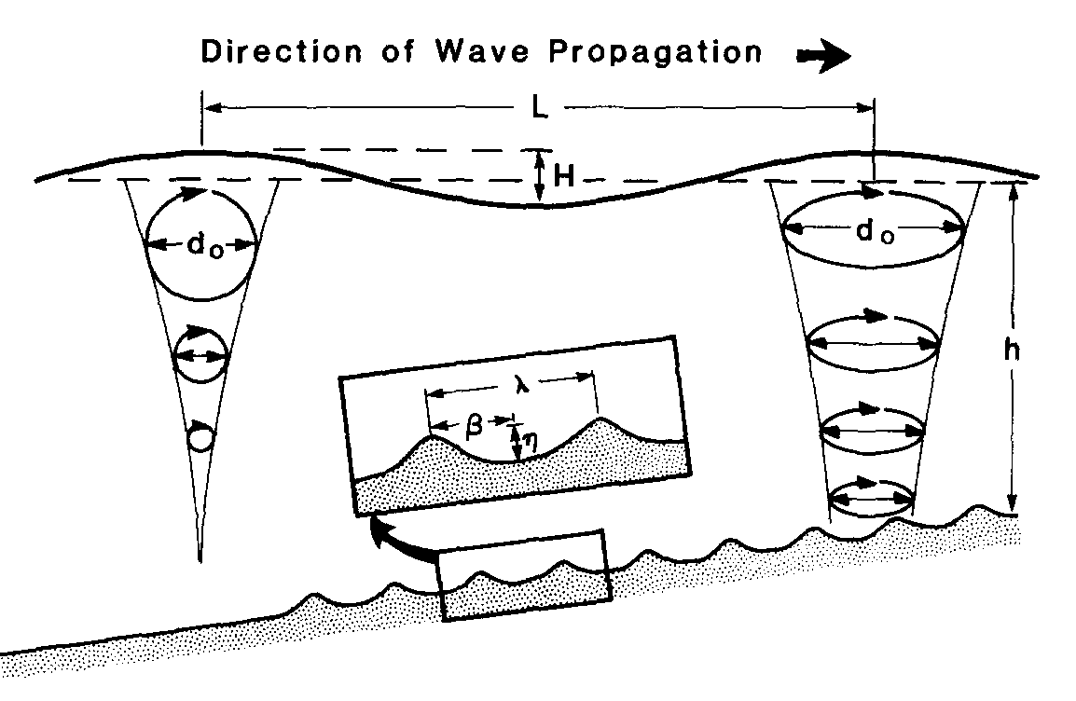

Waves generate oscillating flow near bed
Airy, shallow water:
Clifton & Dingler [1984]
Sand in suspension settles in troughs
Ripples arise from an instability in sediment transport over bed perturbations. Avalanching + settling limit growth
For flow to
the right:
Flow accelerates over bump
→ increasing τ, erosion
Flow separation
τ drops,
deposition
Avalanching
3 cm
Notes:
Instability that leads to formation of ripples (show flume movie and numerical model). Labels for flow to the right.

Slide 3
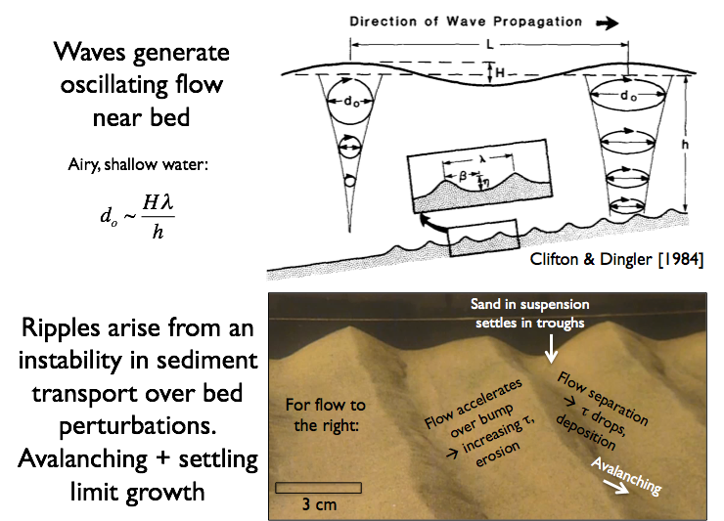

Slide 5
Field-scale wave tank experiments to study ripple evolution under controlled conditions
Spotlight illumination
Time-lapse camera triggered every N wave periods (experiments last >10⁴ periods)
Variable-speed electric motor drives paddle
0.18 mm sand, water depth 30-40 cm
“Beach” of polymer mats damps reflection
Open duct 60 cm wide x 50 cm deep

Slide 6
Ripples spreading from an initial bump
Light direction
30 cm
1 second in movie = 10 minutes real time
Notes:
Time-lapse reveals mechanisms that would be very difficult to observe in the field. 10 periods/photo * 2 sec/period * 30photos/sec movie ~ 600 sec / sec movie

Slide 7
Experiments
  Initial bed grown from leveled, raked sand to equilibrium ripple wavelength
  Step change in wave orbital diameter causes ripple wavelength to lengthen or shorten by up to 5 cm
Light direction
40 cm
1 second in movie = 10 minutes real time

Slide 8
Experiments
  Initial bed grown from leveled, raked sand to equilibrium ripple wavelength
  Step change in wave orbital diameter causes ripple wavelength to lengthen or shorten by up to 5 cm
Light direction
40 cm
1 second in movie = 10 minutes real time

