Slide 1

Colorado College Geodesign Workshop -- ‘ prep ‘ talk
This six-slide ‘prep talk’ serves as a self-paced “pre-session” that will acquaint you with Workshop goals, and stimulate your thinking about the CC campus and its urban perimeter. Here we introduce “the problem” to be explored in the Workshop, and offer information about opportunities for change that may exist in the near future.
Can you imagine changing the campus landscape for the better ?
Where ? Why ? How ? For whom ?
Content of the 8 slides that follow:
The ‘prompt’ for our workshop problem
The Geoforage app
Sites with possibilities for immediate action: a. New construction on campus
  Urban ecology via Gardens and plantings; Campus as Arboretum
  Monument Creek – environmental restoration and multi-use
  Transportation
Supporting information: Geodesign background and Campus project location map
Notes:
Purpose: Use Geodesign methods to plan and create a CC campus landscape that is suited to its regional climate, hydrology, and urban setting today and in the coming decades.
Working together as members of the campus and community, identify sites and design interventions that allow the campus landscape to: 1) function in harmony with earth surface processes; 2) provide outdoor environments for learning, reflection, and relaxation; and 3) stimulate the tendencies of residents of campus and city center for environmental stewardship.
Geodesign background:
Geodesign is an approach that addresses spatial challenges that arise in built and natural environments,
using relevant scientific and geographic data assembled within a GIS framework. It uses an open, iterative process that allows integration of priorities, viewpoints, and data resources from specialists, administrators, community members and other stakeholders. Examples of priorities that guide our campus geodesign process are sustainability, energy efficiency, economic factors, infrastructure, risk and resilience, water and stormwater management, urban ecology, and aesthetics.
Why now?
Colorado Springs is experiencing a pulse of urban renewal and revitalization of its City center, which coincides with efforts in restoration of the City’s waterways, Monument Creek and Fountain Creek. The City recently experienced devastating fires and floods at the mountain-urban interface, that have spurred efforts to stabilize mountain slopes, and identify suitable vegetation and emplace water control structures that help to reduce the loss of infrastructure. There is a shift in residential design toward space- and energy- efficient accommodations and a health, “livable” urban environment.

Slide 2
I. Colorado College Geodesign Workshop -- Purpose
Introduce Geodesign methods, and use them to plan and create a CC campus landscape that is suited to its regional climate, hydrology, and urban setting, today and in the coming decades.
Working together as members of the campus and community, identify sites and design interventions that allow the campus landscape to:
Geodesign is an iterative process. Once viable designs are achieved, with a suitable degree of support from workshop participants and stakeholders, the designs will be presented to College administration and City decision-makers, with the aim that the designs be implemented.
function in harmony with earth surface processes
provide outdoor environments for learning, reflection, and relaxation
stimulate the tendencies of residents of campus and city center for
environmental stewardship.

Slide 3
II. The Geoforage app
The position of the blue polygon can be moved, positioned, and re-sized, on the map. Click on the image to open the app. Pan and zoom the map; drag polygon or the handles to place and size it.

Slide 4
II. Sites with possibilities for immediate action: a. New construction on campus
From 2015 CC Campus Master plan: FUTURE INITIATIVES
Olin Hall demolished, replaced
by New Science building
M o n u m e n t C r e e k P a r k
See pp. 82-83
of CC master plan.
New tennis courts, above a parking ramp
New ice arena and natatorium
Notes:
From 2015 CC Campus Master plan, p. 82-83

Slide 5
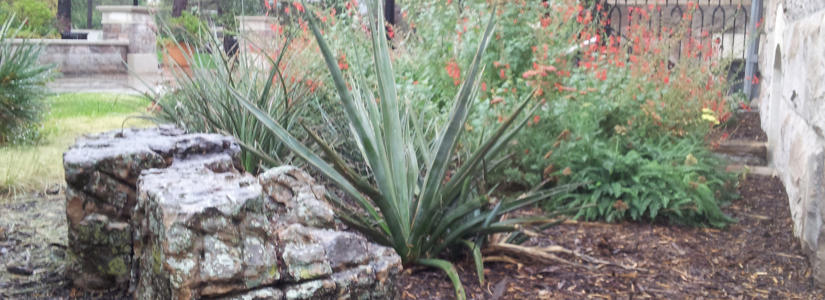
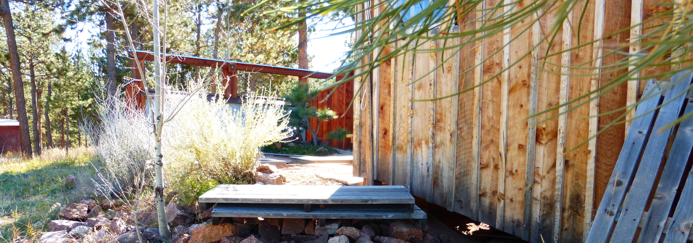
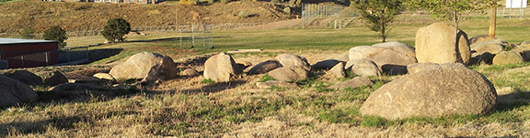
Sites with possibilities for immediate action: b. Urban ecology via Gardens, “Campus
Arboretum,” CC Farm, and Plantings (components of 2015 Campus Master Plan)
Projects 10 and 16
Colorado BIOME and ECO-VILLAGE GARDENS
Underutilized parking will be removed from the center of the middle block of east campus. It will be replaced with expanded agricultural landscapes to be maintained by students and faculty.
Project 34
SPECIALTY GARDEN ENHANCEMENTS
Thematic and Specialty Gardens should be invigorated to have stronger pedagogical relationship to the overall campus and student life. Enhancements could include the addition of interpretive signage and greater visibility and access.
Project 35
COLORADO COLLEGE FARM
Improvements to the CC Farm: increase in available farming space; provide for a direct visual and secure pedestrian access to the Monument Creek Park.
See p. 93, and pp. 166 through 177 in Campus Master Plan
Notes:
Campus master plan, pages 1 – 47, https://sites.coloradocollege.edu/csiddoway/files/2018/10/CC_CampusMasterPlan_2015_p1-47.pdf
Campus master plan, pages 48-80, https://sites.coloradocollege.edu/csiddoway/files/2018/10/CC_CampusMasterPlan_2015_p48-80.pdf
Campus master plan, pages 81-181, https://sites.coloradocollege.edu/csiddoway/files/2018/10/CC_CampusMasterPlan_2015_p81-181.pdf

Slide 6
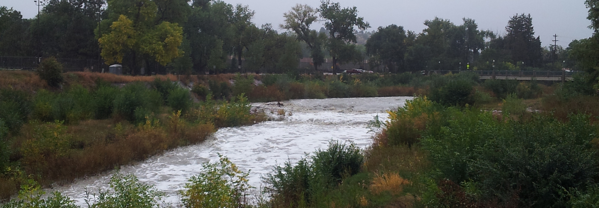
II. Sites with possibilities for immediate action: c. Monument Creek – environmental restoration,
education, health and wellness, and multi-use
Directives from Sustainability Knowledge Development Team’s Final Report (2013):
• Significantly strengthen our connections to “our communities” and our environment.
• Bring Monument Creek into the campus and into the curriculum.
• Allow rainwater infiltration to reduce damaging runoff
• With new building construction, design surrounding landscape
so that stormwater is slowed and managed within the
immediate surroundings.
CC master plan pp. 92-93, 149, 164, and 174-177
Notes:
See page 92-93, 149, 164, and 174-177 Sustainability

Slide 7
II. Sites with possibilities for immediate action: d. Transportation and carbon neutrality
Several “opportunities for change” are interrelated.
• Are there sufficient options for public transportation and/or vehicle-sharing?
• How much of the campus landscape should be devoted to parking? Are individual vehicles consistent with the College mission statement?
• Can water management goals be met when a large percentage of the campus is covered with impermeable pavement ?
• Are campus landscape and transportation frameworks contributing to or helping to address 21st Century climate change in the region and the world?
Many CC students desire workable alternatives to individually owned cars, on this walkable campus. An agreement with a car sharing company such as Zipcar might provide a small vehicle fleet for student short-term rental. The program could be housed together with the Bike Co-op (a bicycle advocacy and repair program) in a Intermodal Transportation Center (e.g. p. 93 Campus master plan)
Notes:
Can the CC campus landscape be developed as a vital example of Geodesign for environmental change within an urban landscape?

Slide 8
Geodesign background:
Geodesign is an approach that addresses spatial challenges that arise in built and natural environments, using relevant scientific, geographic, and demographic data. It uses an open, iterative process that allows integration of priorities, viewpoints, and data resources by groups of specialists, administrators, community members and other stakeholders.
Examples of priorities that guide our campus geodesign process are sustainability, energy efficiency, economic factors, infrastructure, risk and resilience, water and stormwater management, urban ecology, and aesthetics.
Why now?
Colorado Springs is experiencing a pulse of urban renewal and revitalization of its City center, which coincides with efforts in restoration of the City’s waterways, Monument Creek and Fountain Creek. Within the past decade, the City experienced devastating fires and floods at the mountain-urban interface, spurring efforts to stabilize mountain slopes, identify suitable vegetation, and develop floodwater control structures that help to reduce the loss of infrastructure. There is a shift in residential design toward space- and energy- efficient accommodations and a health, “livable” urban environment.
LINK TO FURTHER RESOURCES
Notes:
Further resources: see http://sites.coloradocollege.edu/csiddoway/geodesign-at-cc/

Slide 9
Project 9 Intermodal
Transportation Center
Project 10 Colorado Biome
Project 16 Eco-Village Gardens
Project 34 Specialty Garden
Enhancement
Project 35 CC Farm
Plus: CAMPUS AS ARBORETUM
See Campus master plan, pages 130-131
See pp. 169-170 of campus master plan.
Notes:
Campus master plan, pages 130-131, within https://sites.coloradocollege.edu/csiddoway/files/2018/10/CC_CampusMasterPlan_2015_p81-181.pdf

